Slide 1

ITDA, Inc.
“Connecting Technology and People”

Slide 2
Is ITDA reliable?

Slide 3

Company Overview

Slide 4
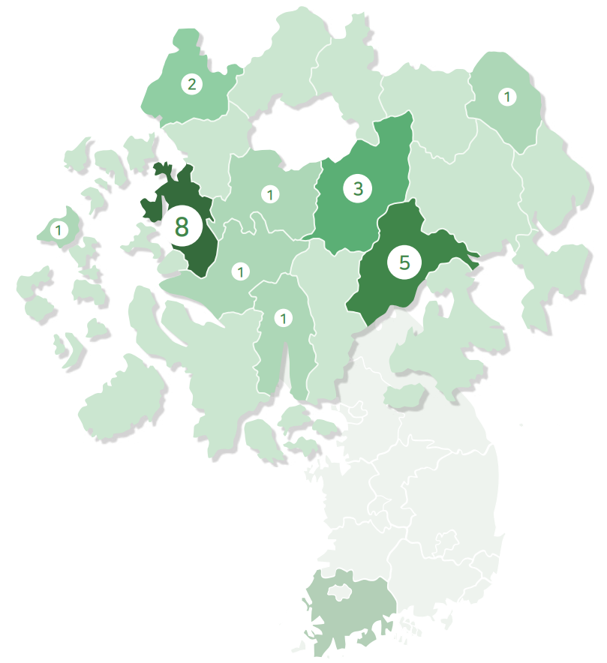
Farm Location
Virus-free
Jeollanam-Do
‘전라남도’

Slide 5
Export History
2019
2021 Jan. ~ Apr.
x11
$19,098
$214,422

Slide 6
Company Growth
$17,417,368.00
2021 First-half Sales Revenue
391.3%
CARG in 3 years
$261,260.52
Attracted Investment
$300,000.00
Export Sales Revenue
in 3 years

Slide 7
Our Products
Boseong Nokdon (Green tea-fed pig)
KOKODUCK (Naturally smoked duck)
Sundae (Korean traditional sausage)
COCORICO (Raw Chicken)
Duck neck (pet food)
Soy sauce crab
Korean beef

Slide 8
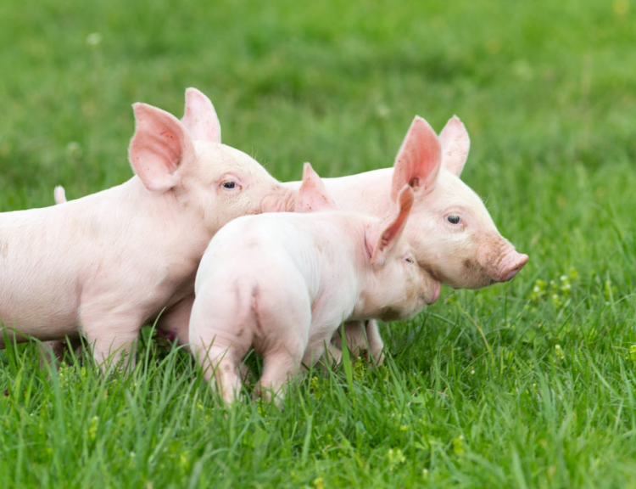
Boseong Nokdon (Green tea-fed pig)

Slide 9
4 Traits
Special Taste
Healthy
Brand Value
Packaged Product

Slide 10
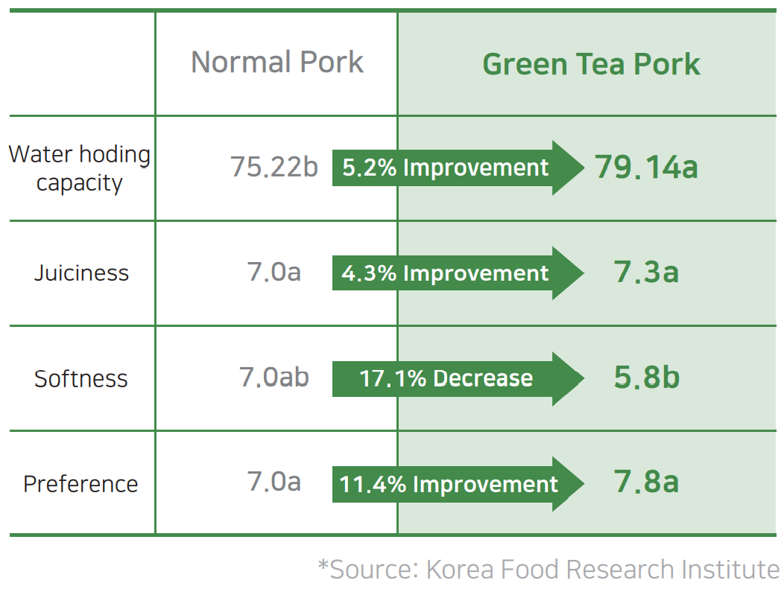
1) Special Taste

Slide 11
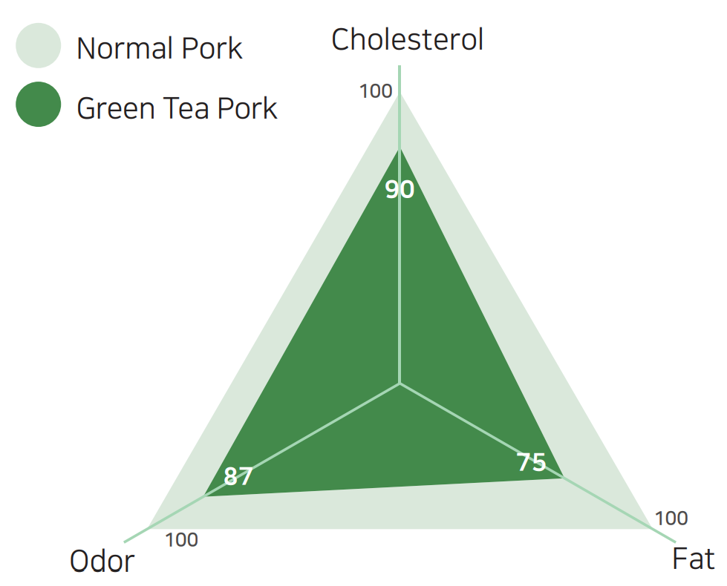
2) Healthy
*Source: Korea Food Research Institute

Slide 12
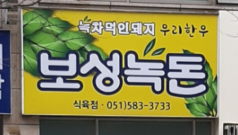
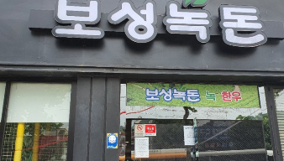

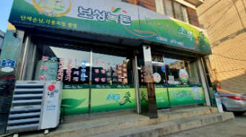
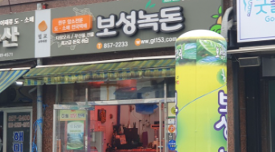
3) Brand Value (Patent)
130 Restaurants

Slide 13
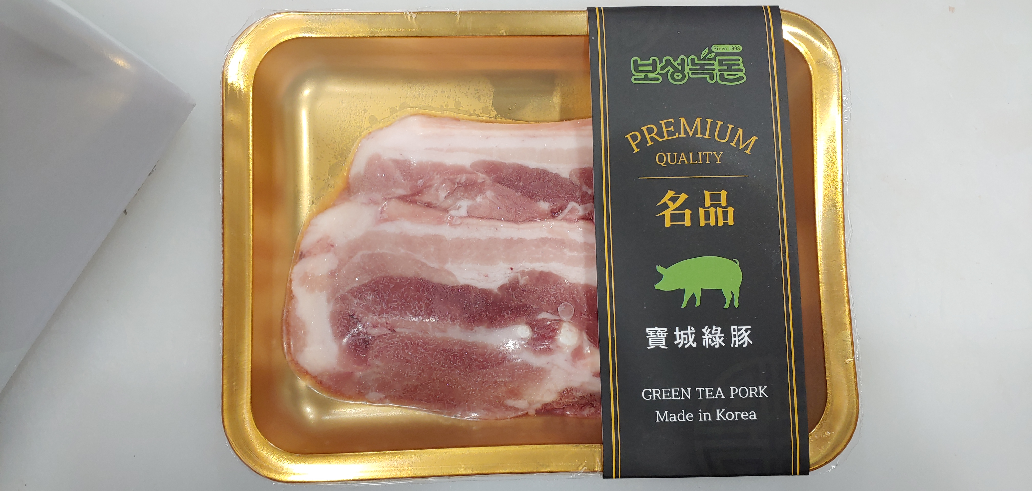
4) Packaged Products – Pork Belly

Slide 14
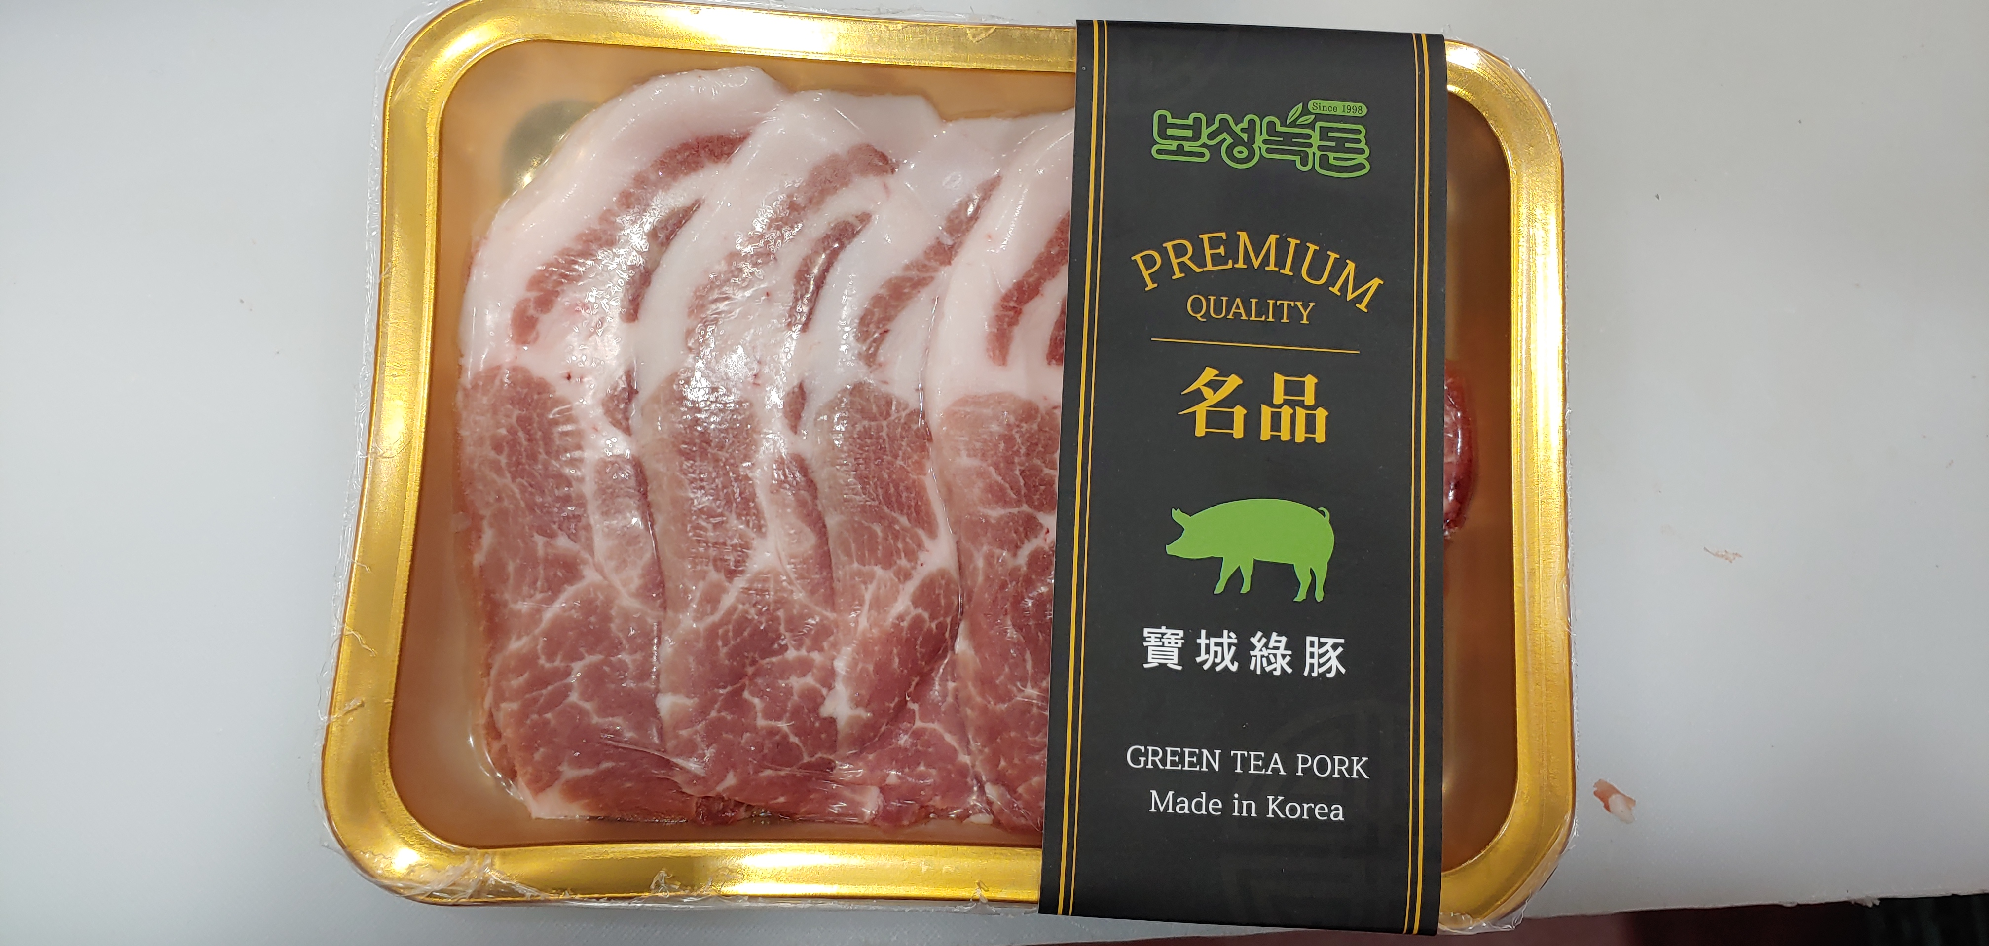
4) Packaged Products – Shoulder Butt

Slide 15
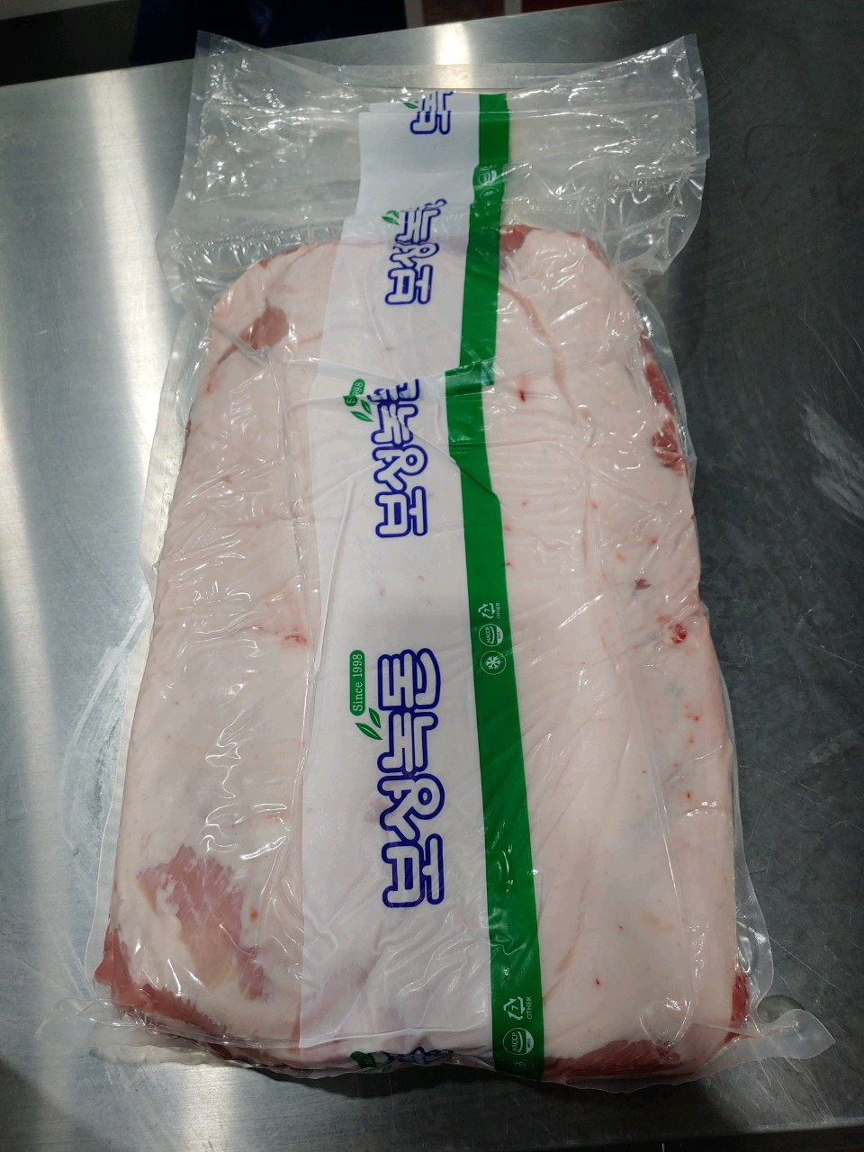
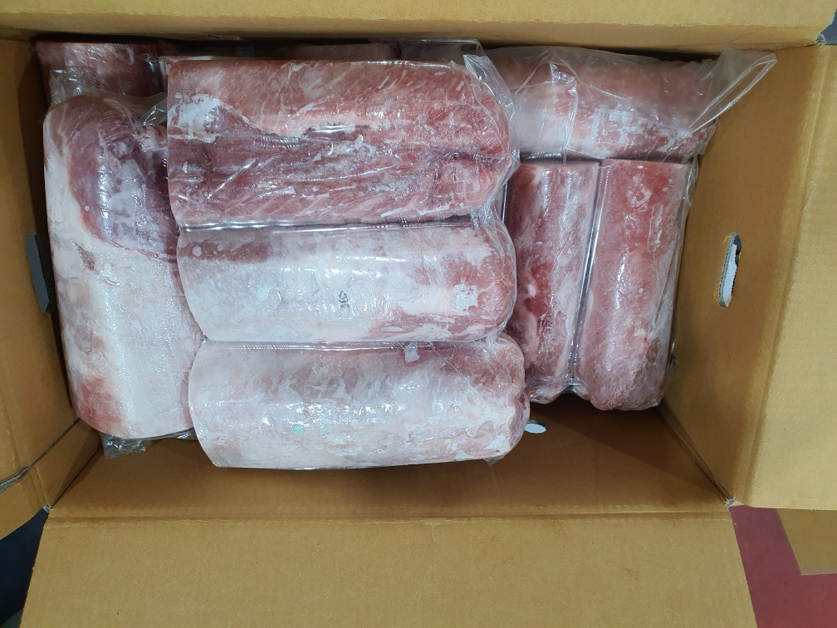
Bulk Product

Slide 16
Any Questions?

Slide 17
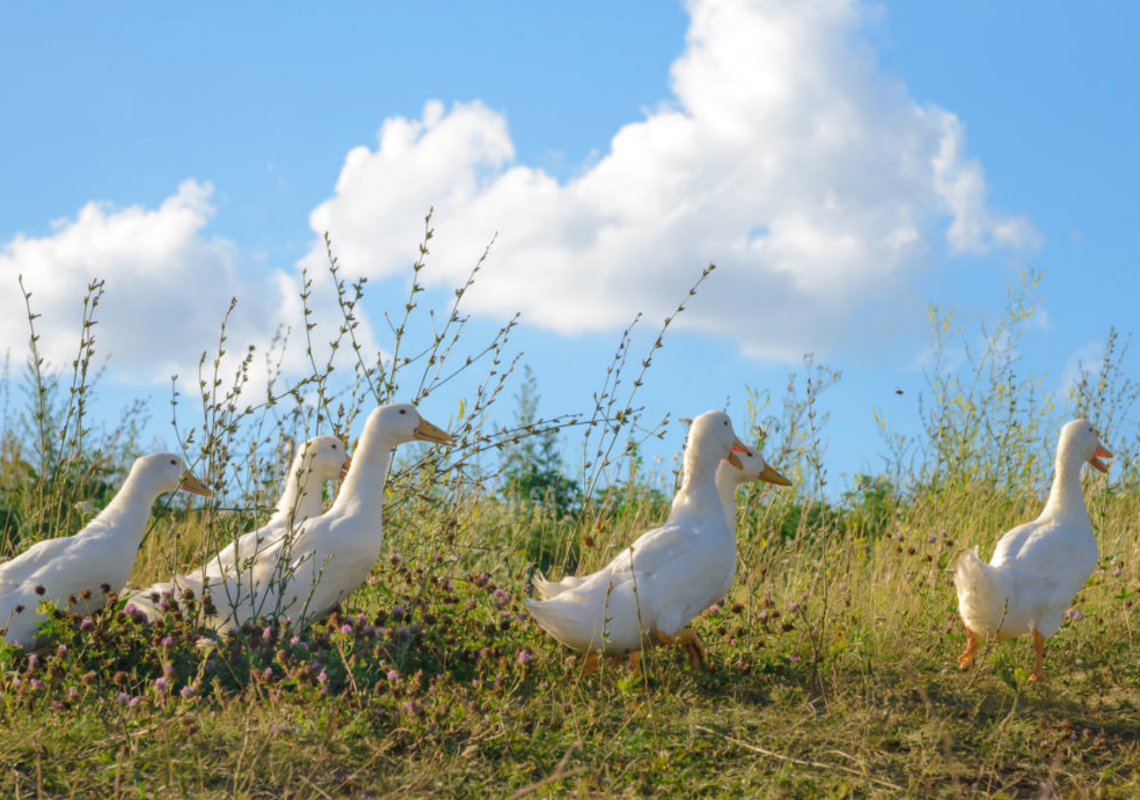
KOKODUCK (Naturally smoked duck)

Slide 18
4 Traits
Special Taste
Healthy
Market Share
Retort Product

Slide 19
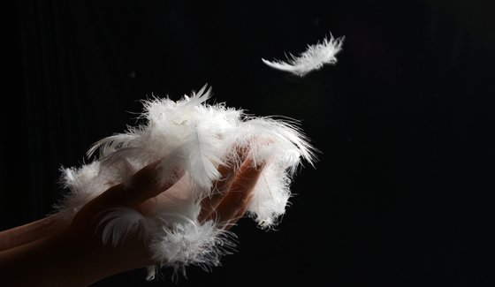
1) Special Taste – Only for food

Slide 20
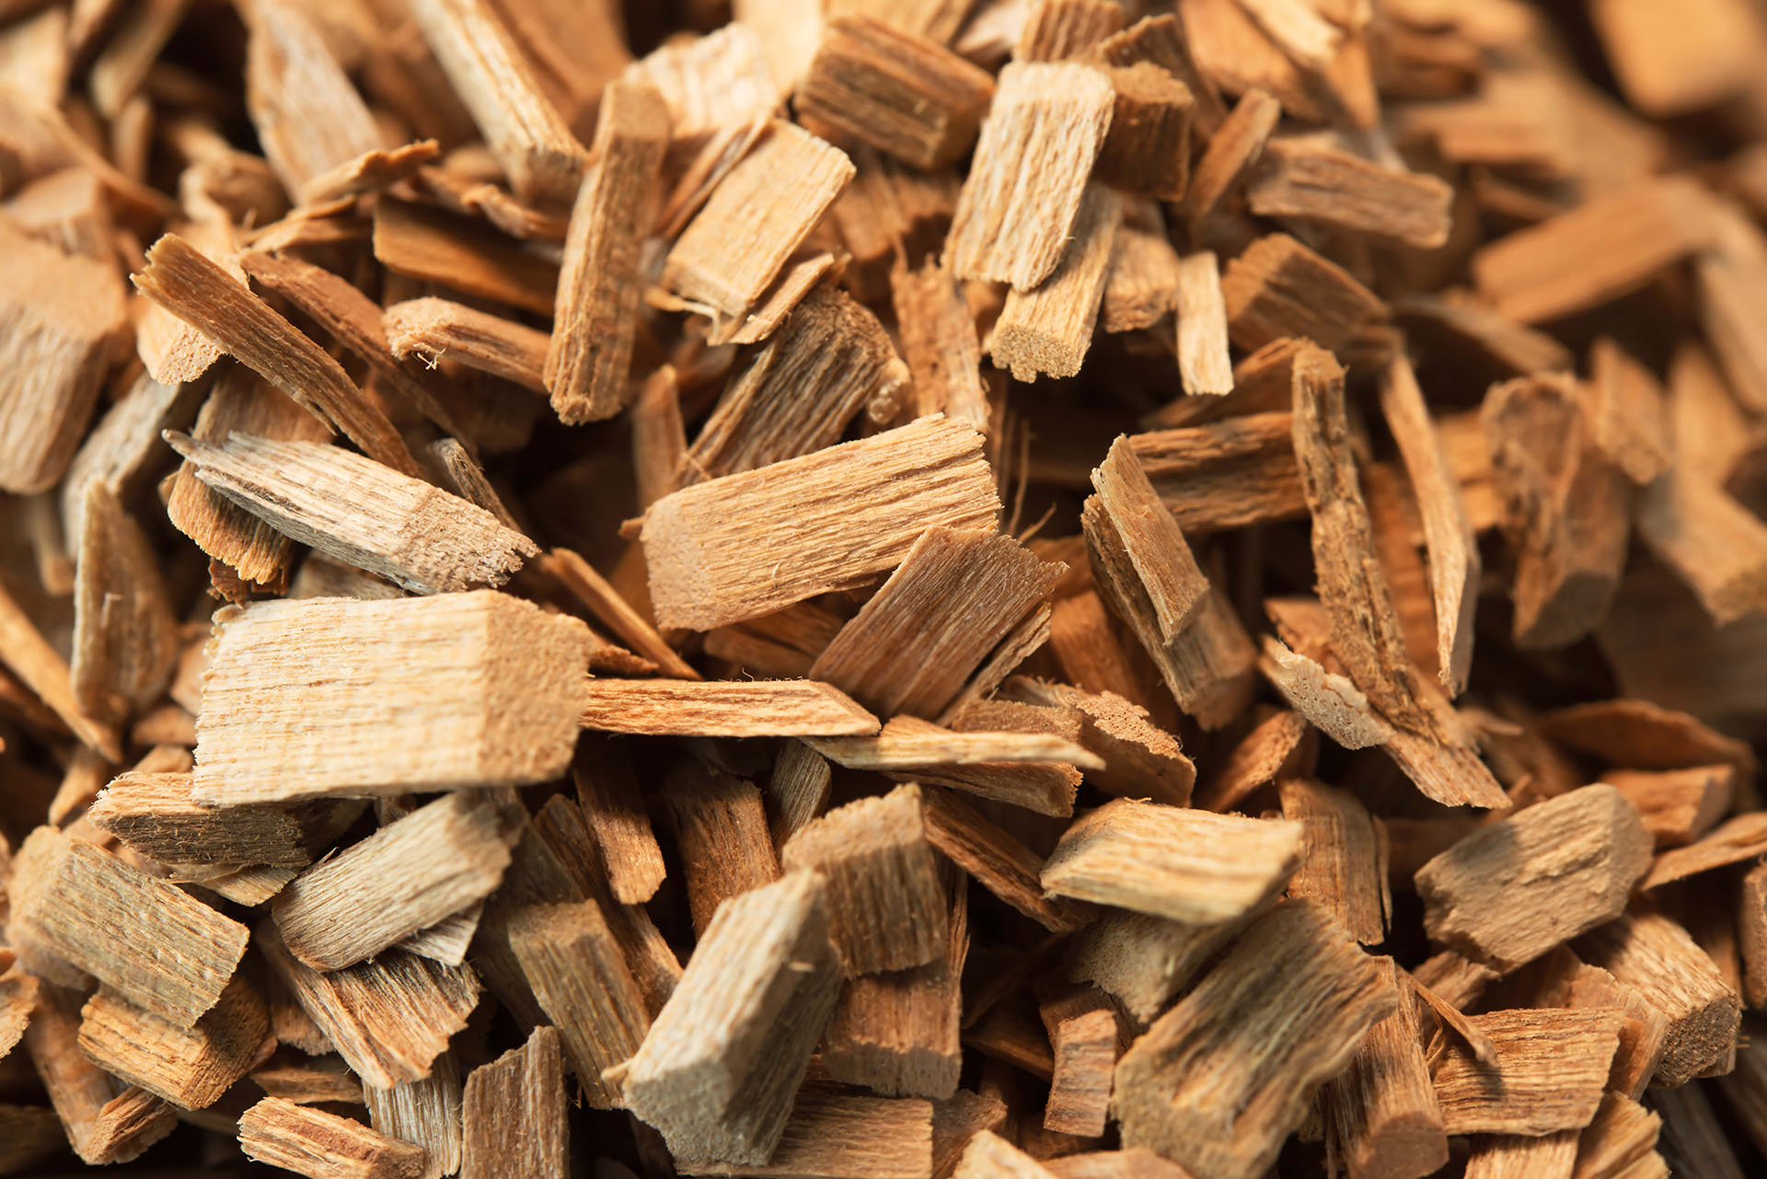
1) Special Taste – Natural made
Antibiotic
Preservative
Growth Accelerator
Oak Tree

Slide 21
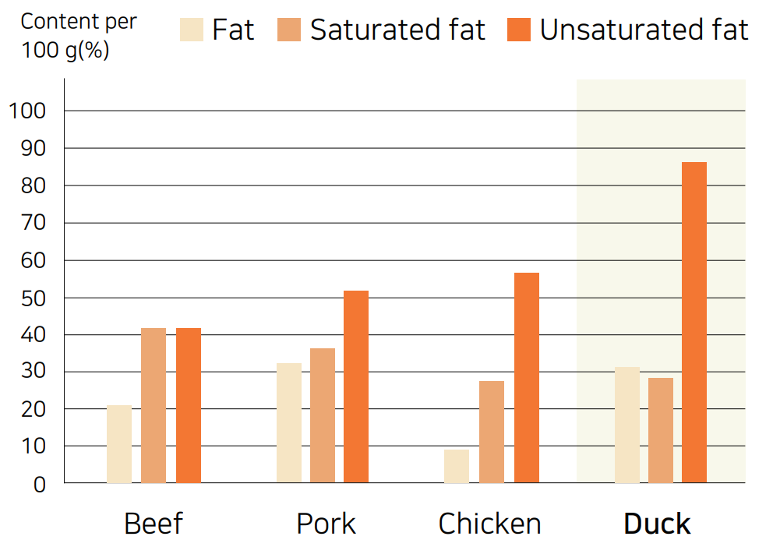
2) Healthy

Slide 22

3) Market Share – 30%
First in S.Korea
Circulated in Supermarkets

Slide 23
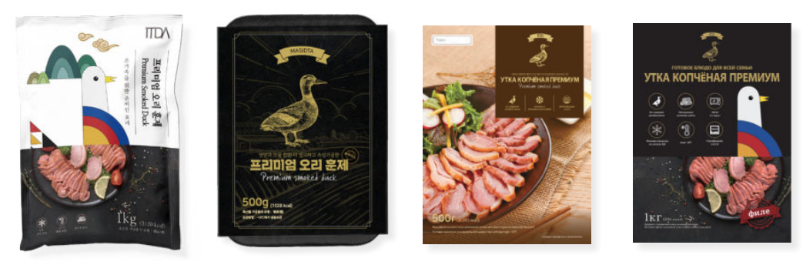
4) Retort Products (Bulk Possible)

Slide 24
Any Questions?

Slide 25
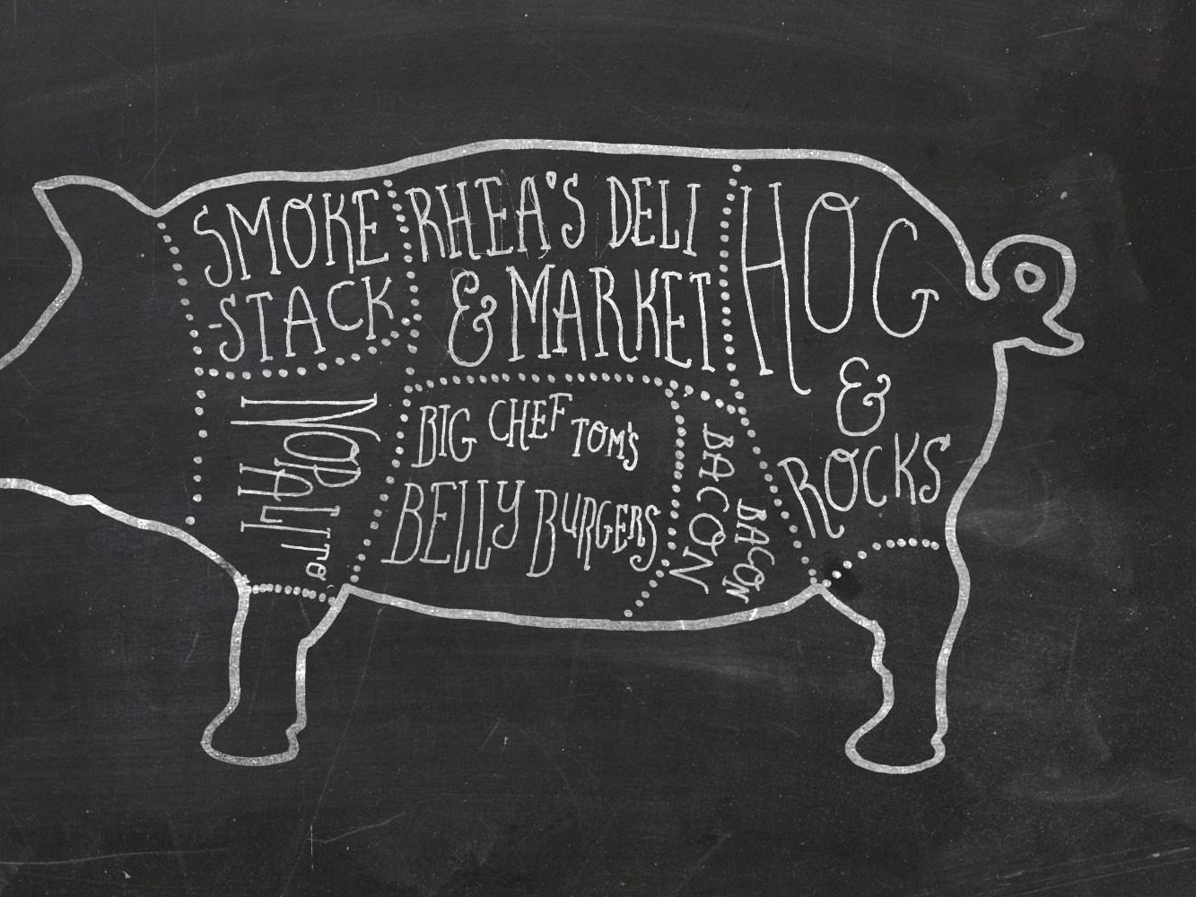
Pork Products

Slide 26

www.itda.io

Slide 27

Extra Information

Slide 28
OEM, (Packaging)
However you want

Slide 29

Expiration Date
Frozen(bulk): 2 years
Retort: 6 months -> 1 year

Slide 30

MOQ
Condition:
1 TEU(20ft),
FCL(no mixing)
Size:
1 TEU = 750box (10kg per box) = 7,500kg

Slide 31
Good People, Lasting Partnership

Slide 32
ITDA, Inc.
“Connecting Technology and People”

Slide 38
Price
Varies by:
Auction Price
Season
Part
We assure:
Lowest Possible

Slide 39
Part | Weight | Price(won)
Tender loin | 1.15392 | 12650
Loin | 7.01968 | 12350
Boston shoulder | 5.2888 | 23100
Pork belly | 10.76992 | 24910
Spareribs | 3.65408 | 12700
Picnic shoulder | 10.86608 | 12730
Ham | 17.02032 | 7480
Pork jowl | 0.7212 | 39930
Pork cheek meat | 0.28848 | 35280
Skirt meat | 0.33656 | 31110
Source: 2020 4th quarter Livestock Products Circulation Information Research report by KAMIS

Slide 40
Price
<Retort>
Product | Price
Retort whole smoked duck | $14.5 per 1,000g $8.5 per 500g
<Frozen>
Product | Approx. Weight (g)
Smoked whole boneless duck | $13.96 per 1,000g $7.66 per 500g
Smoked whole duck with bones | $13.51 per 1,000g
Sliced smoked duck | $14.41 per 1,000g $8.11 per 500g $5.41 per 300g
Smoked duck breast | $20.72 per 600g $10.81 per 300g
Sliced smoked duck breast | $11.26 per 300g

